Slide 1

DETECTION OF ROAD LANES AND TRAFFIC SIGNS. (Internship Project)
By Namita S
(Data Science Intern at Soften Technologies)
August 2024

Slide 2
CONTENTS
Introduction
Objectives
Data Collection
Model Development
Training and Evaluation
Demonstration & Presenting the User Interface
Conclusion

Slide 3
INTRODUCTION
Overview: The project focuses on the detection of road lanes and traffic signs using Computer Vision and Deep Learning techniques. This is a critical component for autonomous vehicles and advanced driver-assistance systems (ADAS) to ensure safe and efficient navigation.
Importance: Accurate detection of road lanes and traffic signs provides real-time information to the vehicle about the road layout and regulatory signs, enhancing the safety and efficiency of autonomous driving.

Slide 4
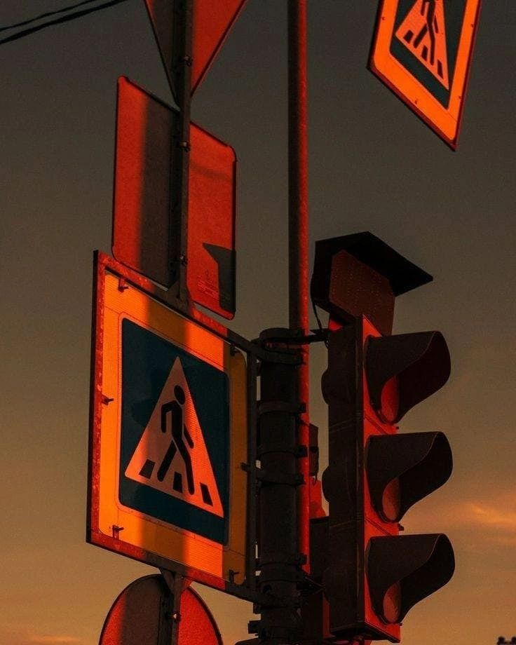
This presentation explores techniques to achieve robust lane detection using computer vision and employs a deep learning model for real-time traffic sign recognition.

Slide 5
OBJECTIVES
Lane Detection:
Identify lane boundaries on roads using computer vision techniques.
Develop an algorithm to detect and extrapolate lane markings.
Traffic Sign Recognition:
Implement a deep learning model (YOLOv3) for detecting various traffic signs.
Develop an algorithm to detect and extrapolate traffic sign recognition.

Slide 6
DATA COLLECTION
Lane Detection:
Utilized images from the Udacity Self-Driving Car Nanodegree project.
Also have used ‘KITTY ROAD/LANE Detection’ data set for testing the model
Includes scenarios with clear lane markings under varying environmental conditions.
Traffic Sign Recognition:
Leveraged the COCO dataset for YOLOv3 pre-trained weights.
Dowloaded TINY LISA Traffic Sign Detection from Kaggle.
Augmented data with additional traffic sign images to enhance model robustness.

Slide 7
Example Images:
Presenting a few sample images from the datasets to illustrate the types of data used by Cloning the repository and from TINY LISA Traffic Sign Recognition Dataset.

Slide 8
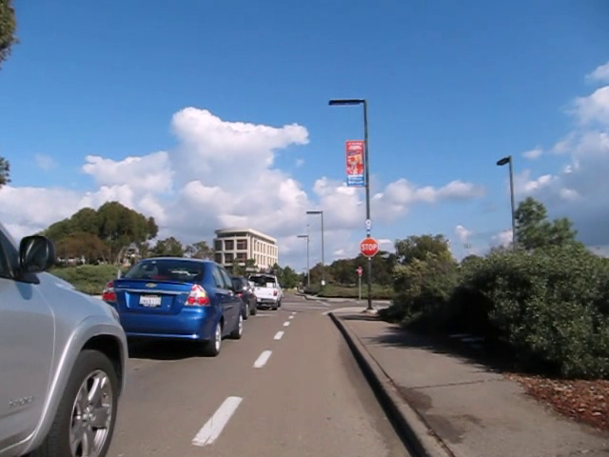

Slide 9
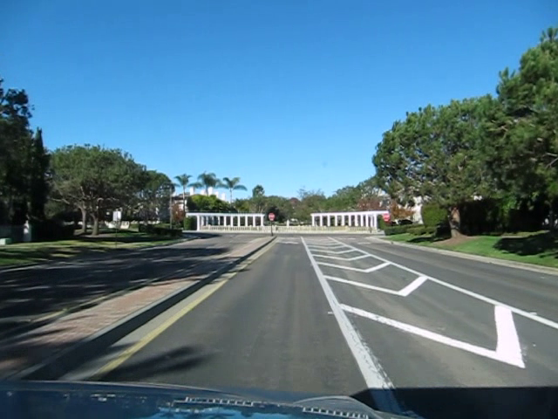

Slide 10
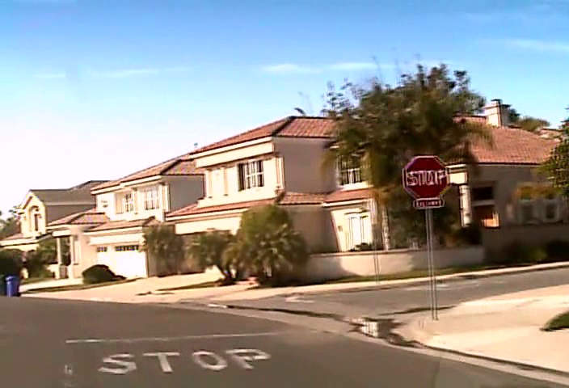

Slide 11
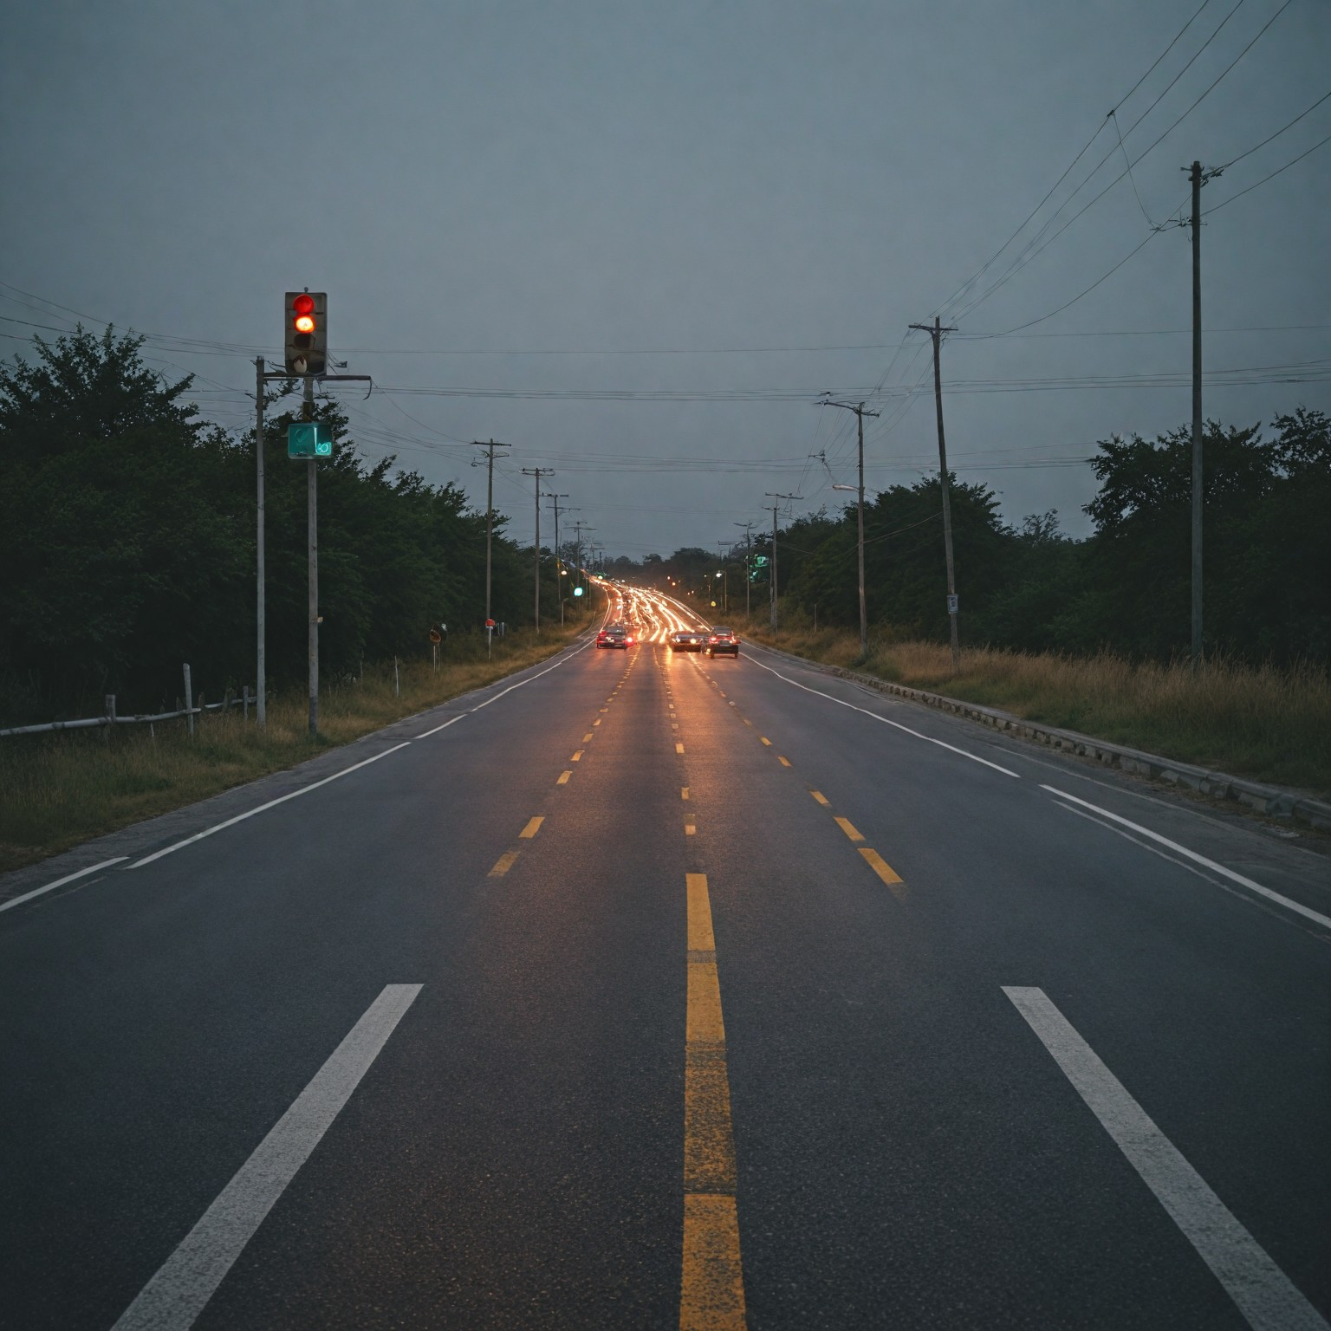

Slide 12
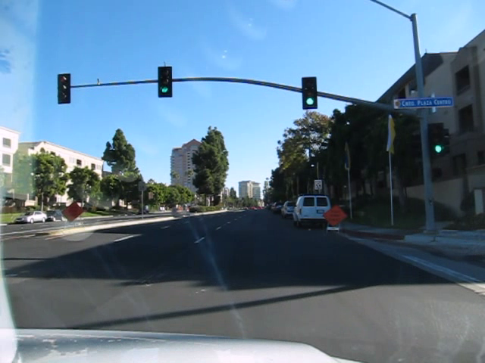

Slide 13
MODEL DEVELOPMENT FLOWCHART
Lane Detection Pipeline
Color Selection and Region Masking
Canny Edge Detection
Hough Transform
Lane Detection
Output Visualization

Slide 14
Traffic Signs Recognition Pipeline
Image Acquisition
Preprocessing
Traffic Sign RecognitionYoloV3 (As a CNN model)
Output Visualization

Slide 15
MODEL DEVELOPMENT
LANE DETECTION PIPELINE
1) Color Selection and Region Masking
Identifying lane markings based on color thresholds.
Masking a region of interest (ROI) to focus on lane detection.
2) Canny Edge Detection
Detecting edges in the grayscale image to highlight potential lane lines.

Slide 16
3) Hough Transform
Transforming detected edges into lines and extrapolating to identify lane boundaries.
4) Output Visualization
Overlaying detected lane lines on the original image for visual confirmation.

Slide 17
TRAFFIC SIGN RECOGNITION PIPELINE(YOLOv3)
1) Pre-processing
Resizing and normalizing input images for YOLOv3.
2) Object Detection
Utilizing YOLOv3 to detect traffic signs within the image.
3) Postprocessing
Filtering detections using non-maximum suppression (NMS) and drawing bounding boxes.

Slide 18
TRAINING AND EVALUATION
Lane Detection:
Visual Inspection: Results were assessed by visually inspecting the images to ensure that lane markings were accurately detected and clearly represented.
Sample Images: The system was applied to a set of sample images under different conditions (e.g., varying lighting, road curvature) to gauge robustness and reliability.

Slide 19
Traffic Sign Recognition:
Evaluation Metrics:
Accuracy: 0.75
Precision: 0.75
Recall: 0.75
F1 score: 0.75
Comparative analysis against ground truth labels.

Slide 20
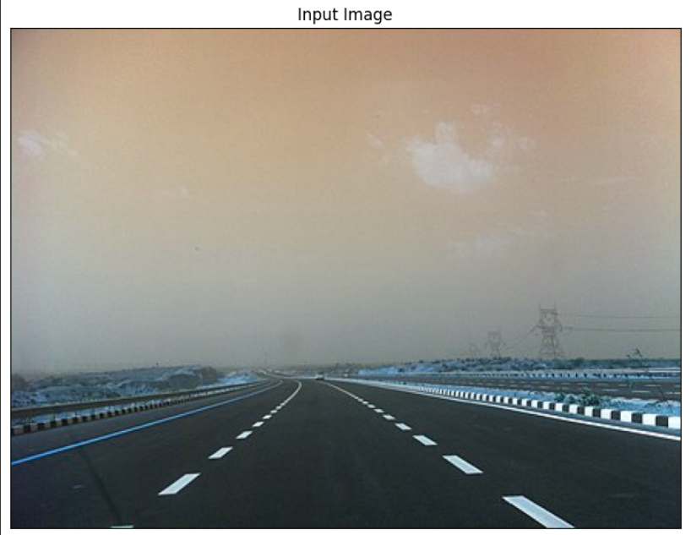
DEMONSTRATION
Lane Detection Example
Input Image:

Slide 21
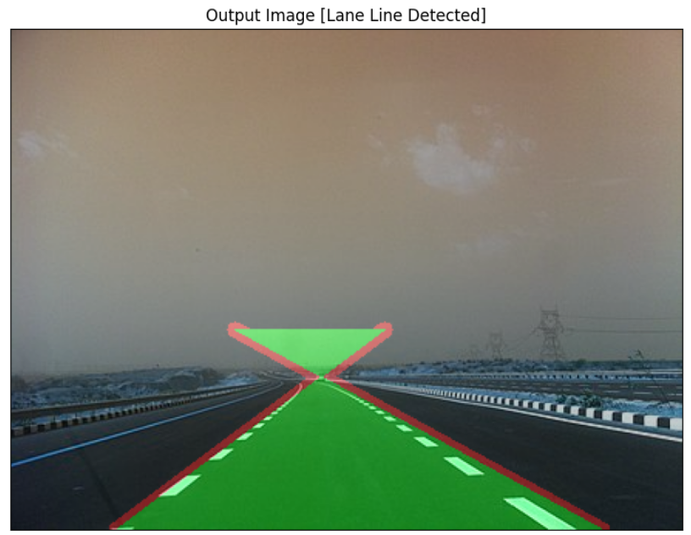
Output Image:
Highlighting detected lane lines overlaid on the input image.

Slide 22
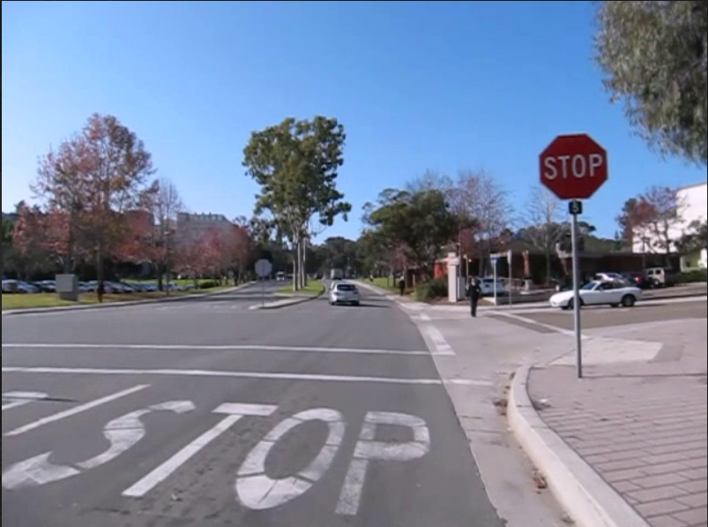
Traffic Sign Recognition Example
Visualizing detected traffic signs with bounding boxes and labels.
a) Input Image:

Slide 23
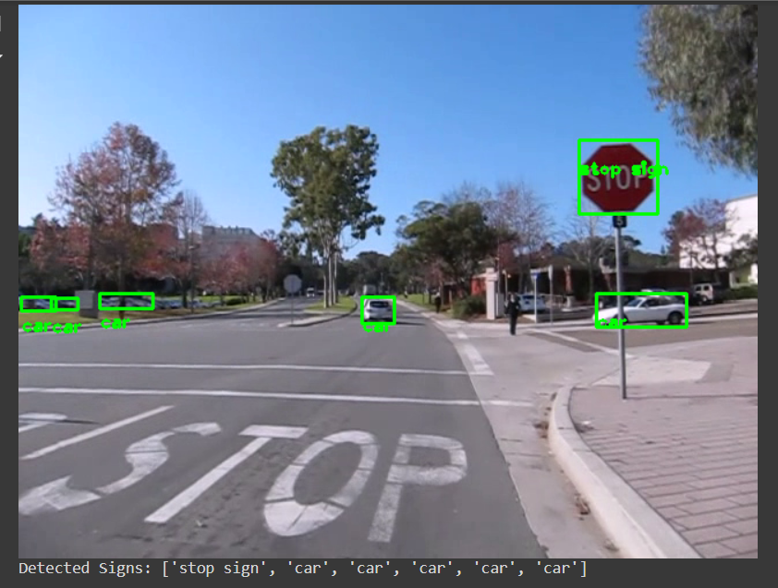
b) Output Image:

Slide 24
USER INTERFACE (For Lane Detection and Traffic Sign Recognition)
The user interface (UI) has been developed using Gradio to provide an interactive platform for testing lane detection and traffic sign recognition functionalities. This interface simplifies the process of uploading images and selecting the desired processing task, allowing users to visualize the results in real-time.

Slide 25
Interface Components
1) Input Image
Description: Users can upload an image file directly into the interface.
Type: ‘numpy’ array (for image processing compatibility)
Purpose: To provide the image data that will be analyzed by the underlying models.
2) Task Selection
Description: A radio button allows users to choose between two tasks: "Lane Detection" and "Traffic Sign Recognition.“
Choices:
Lane Detection: Detects and highlights road lanes in the
provided image.
Traffic Sign Recognition: Identifies and classifies traffic signs
present in the image.

Slide 26
3) Output Image
Description: Displays the processed image with annotations based on the selected task.
Type: ‘numpy’ array (to visualize the results directly)
Purpose: To show the final output of the processing, including lane markings or detected traffic signs.

Slide 27
How It Works
Image Upload: Users upload an image through the input component.
Task Selection: Users select the desired processing task using the radio buttons.
Processing:
For Lane Detection: The image undergoes preprocessing,
edge detection , and line fitting to identify and highlight lanes.
For Traffic Sign Recognition : The image is processed using the
YOLO model to detect and label traffic signs.
Result Display: The processed image is shown with visual
annotations based on the selected task.

Slide 28
Benefits
Interactive : Allows users to interactively test and visualize results without needing to write code.
Real-Time Feedback: Provides immediate feedback on the processed images.
Versatile: Supports multiple tasks (lane detection and traffic sign recognition)within a single interface.

Slide 29
Summary
The Gradio-based user interface enhances the usability of the lane detection and traffic sign recognition models, making it easier for users to engage with and evaluate the capabilities of the developed system.

Slide 30
CONCLUSION
Summary:
Developed a functional system for detecting road lanes and traffic signs.
System evaluated on various environmental conditions.
Potential Improvements:
Enhance model accuracy with larger datasets.
Optimize real-time processing speed.

Slide 31
Achievements:
Successfully implemented robust lane detection using OpenCV techniques.
Deployed YOLOv3 for accurate and real-time traffic sign recognition.
Future Scope:
Enhancing lane detection algorithms for complex road conditions.
Integrating the traffic sign recognition model into autonomous vehicle systems.

Slide 32
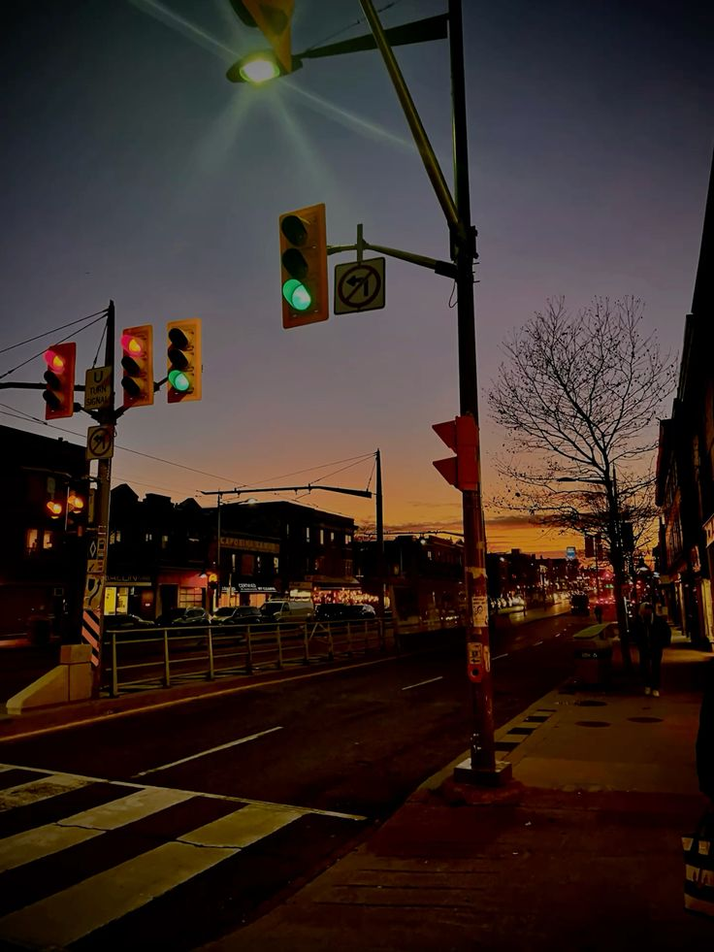
THANK YOU FOR YOUR TIME & ATTENTION.

